Slide 1
Membership Driven
Advocating members’ interests
throughout the watershed
and the Commonwealth…
If you love the lake,
you should join us!
www.SMLAssociation.org
Local Government Awareness
We encourage our membership to participate in local government through attendance at Planning Commission and Board of Supervisors meetings, and to report back to the SMLA office on issues that impact us. Association Business
SMLA is run by a membership -elected Board of Directors. The Board elects its officers which consist of President, Vice-President, Secretary, and Treasurer. Association members and guests are encouraged to attend our monthly Board meetings.
Organization
Begun in 1969, our non-profit, 501 (c) (3) organization is the oldest and largest volunteer association in the area. We include nearly 1,300 families, roughly 3,000 members and growing! Because we are non-profit, your membership dues are tax deductible.
Visit our website regularly for the latest Association information and business.
www.SMLAssociation.org
Membership Application
Select your Annual Membership level:
Family Membership $50.00
Silver Membership $100.00
New “Silver” receives complimentary “No Wake” dock sign
Gold Membership $250.00
New “Gold” receives both Lake Map and “No Wake” dock sign
Platinum Membership $500.00
New “Platinum” receives both Lake Map and “No Wake” dock sign
Business Membership $75.00
Total Amount Enclosed: $___________
Name: ___________________
Address: ___________________
Phone: ___________________
E-mail Address(s): (1)_________________
(2)________________
If you would like to participate on a committee, please let us know which one(s)? (They are listed on the inside of this brochure.)
___________________________________
Mail your tax deductible check to:
Smith Mountain Lake Association
400 Scruggs Road, Suite 2100
Moneta, VA 24121
Phone: 540-719-0690
Fax: 540-719-0690
e-mail: TheOffice@smlassociation.org

Slide 2
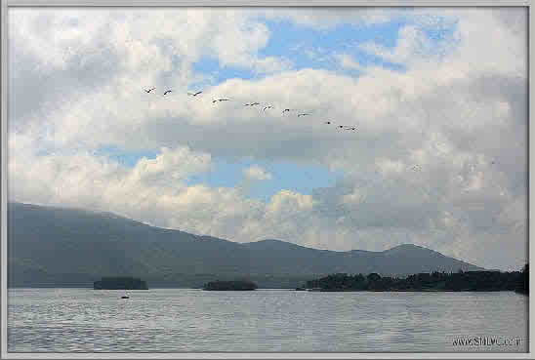
Our Mission
The Association will represent its members on issues that affect Smith Mountain Lake and its watershed. Members’ interests will be advocated throughout the watershed and the Commonwealth using education and information to influence constructive outcomes.
Advocating Members’ Interests Throughout the Smith Mountain Lake Watershed
As volunteers, we work to improve life at the lake and in its watershed by ensuring the protection of water quality, improvement of water safety and other issues that impact the lake to the benefit of all members and visitors. SMLA strives to keep our membership and the public informed of events and important issues relating to Smith Mountain Lake and its watershed, and to gain their input and involvement. We invite you to join us. Work with us to protect and enhance our lake.
SMLA Programs
Environmental Education
Lake Council
Buffer Landscape
Litter
Royal Flush
Water Management
Save the Islands
Lake Issues
Stormwater Runoff
Weed Monitors
Septic Pump-out
Lake Map Program
Local Government
Membership & Business Partners
Office Volunteers
Public/Media Relations
Shoreline Management Plan
Take Pride in SML in cooperation with the SML Regional Chamber of Commerce & TLAC
Water Quality Monitoring
Fertilizer
Save our Streams
Water Safety Council

